Slide 1

ComicsHub.io [01/18/18]
Project Release Plan
Webcomics Team
William Ritson - Product Owner
Myron Pow and Sammy Jia - SCRUM Masters
Alan Wong, James Huang, Mehtab Badh

Slide 2
ComicsHub.io
Project Release Plan
Online webcomic exist but tend to lack features and work poorly on slow connections.
Implement a site where authors can upload comics and have them displayed with a high quality reader.
Reader will support page preloading and be a robust single page application.

Slide 3
Project Release Plan – User Stories
Sprint 1 User Stories
As a... | User Stories | Priority | Story Points
Author | As an author, I want to have my own account, so that I can manage the comics I uploaded. | 1 - Must | 8
Author | As an author, I want to label my comics with titles, so that reader knows what comics they are reading. | 1 - Must | 3
Author | As an author, I want to upload my comic pages, so that other users can watch them. | 1 - Must | 5
Reader | As a reader, I want to have page navigation, so that I can easily navigate to the page I left off. | 1 - Must | 3

Slide 4
Project Release Plan – User Stories
Sprint 2 User Stories
As a... | User Stories | Priority | Story Points
Reader | As a reader, I would like to be able to search for specific comics so that I can easily find content that interests me. | 2 - Should | 5
Reader | As a reader, I would like to be able to return to the last page I read so that I can easily pick up where I left off. | 2 - Should | 3
Reader | As a reader, I want the viewing experience to be smooth, even when my connection is poor, so that I can read the comics with greater ease. | 2 - Should | 5

Slide 5
Project Release Plan – User Stories
Sprint 2 User Stories (cont.)
Reader | As a reader, I would like comics to have easy to link and navigate urls so that I can easily access a specific comic page that I want to read. | 2 - Should | 1
Reader | As a reader, I would like to be notified of updates to comics I have subscribed to so that I know when there is a new chapter to read. | 3 - Nice | 3-8
Reader | As a reader, I would like to be able to rate comics so that I can share my opinions of the comic with the author and other users.. | 3 - Nice | 3
Reader | As a reader, I would like to be able to see the ratings of comics so that I can gauge other users’ opinions of the comic and decide if I should read it.. | 3 - Nice | 3

Slide 6
Project Release Plan – User Stories
Sprint 3 User Stories
Author | As an author, I would like to be able to organize my comic in different ways (page, chapters, volumes), so that users can read my content more easily and it is easier for me to manage my comics. | 2 - Should | 3
Author | As an author, I would like to be able to publish multiple comics using the same account, so that I can release my comics more easily. | 2 - Should | 3
Author | As an author, I want to be able to upload multiple pictures at once, so that I can release my comics more easily. | 3 - Nice | 3

Slide 7
Project Release Plan – User Stories
Sprint 3 User Stories (cont.)
Author | As an author, I would like to schedule pages/chapters to release automatically, so that I can manage my comics more easily. | 3 - Nice | 3
Reader | As a reader, I would like to be able to comment on specific pages, so that I can share my opinions of the comic with the author and other users. | 3 - Nice | 3-8
Author | As an author I would like to moderate my users’ comments, so that I can keep the conversation friendly, constructive, and on-topic. | 3 - Nice | 3-8
Author | As an author I would like to be able to set the alt-text for my comics, so that I may add depth to my content and express myself more easily. | 3 - Nice | 3

Slide 8
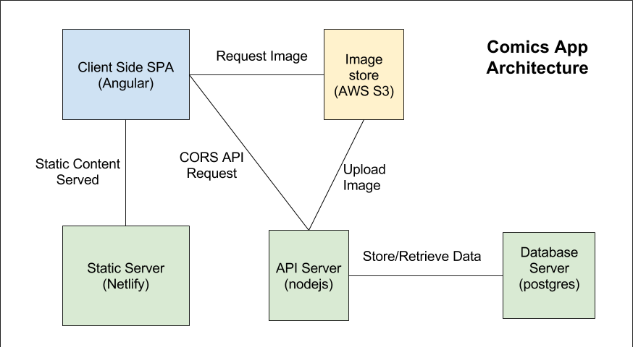
Project Release Plan – Architecture

Slide 9
ComicsHub.io
Project Release Plan – Challenges/Risks
Challenge/Risk 1 - Most team members unfamiliar with Angular
Challenge/Risk 2 - Several servers and services used
Challenge/Risk 3 - Decrease the pictures loading time

Slide 10
ComicsHub.io
Project Release Plan – Technologies
Languages - Typescript and Javascript
Frontend - Angular (2+) and scss
API Server - Nodejs
Database - Postgresql
Image Store - Amazon S3

